Slide 1
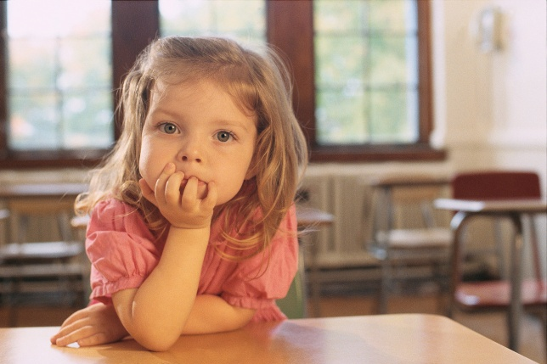
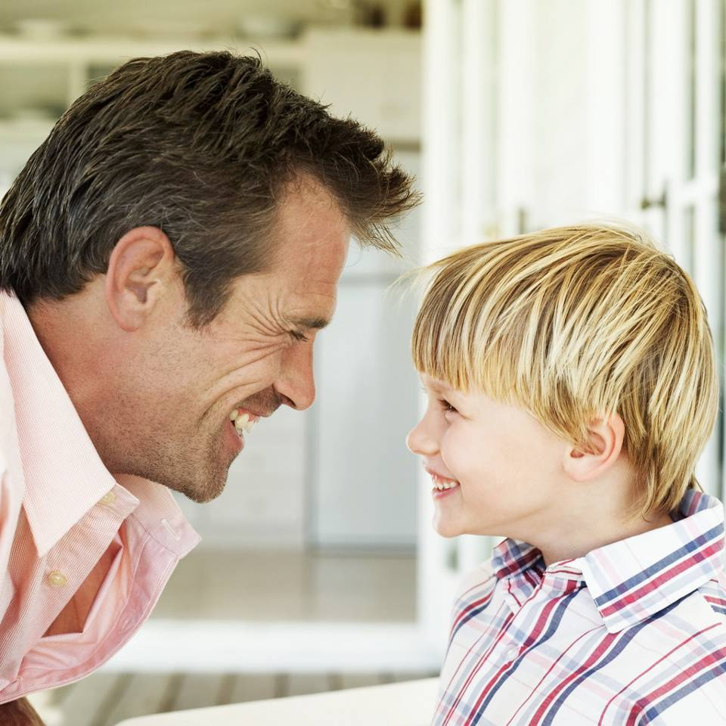
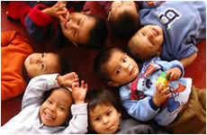
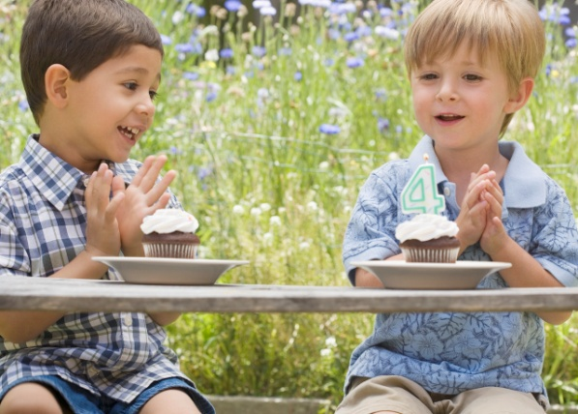
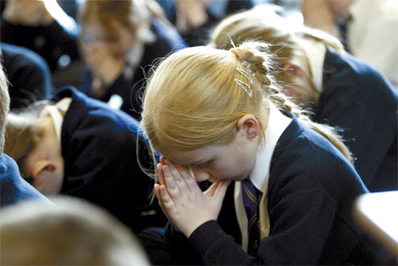
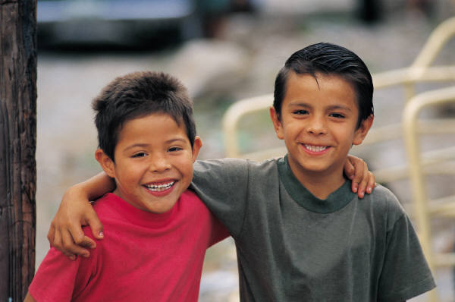
A JOURNEY IN LOve

Slide 2
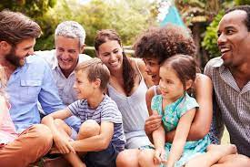
EYFS The wonder of being special and unique
Social and Emotional
LT: To recognise the joy of being a special person in my family.

Slide 3
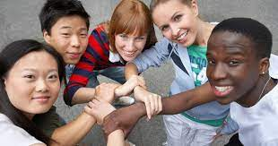
Physical
LT: To recognise we are all different and unique.

Slide 4
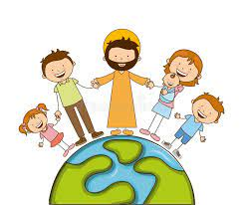
Spirtual
LT: To celebrate the joy of being a special person in God’s family.

Slide 5

Year one We MEET god’s love in our family
Social and Emotional
LT: To recognise signs that I am loved in my family.

Slide 6

Physical
LT: To recognsie how I am cared for and kept safe in my family.

Slide 7
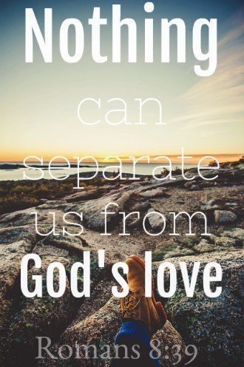
Spirtual
LT: To celebrate ways that God loves and cares for us.

Slide 8
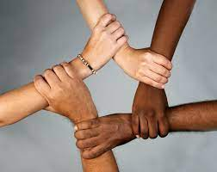
Year two WE MEET GOD’S LOVE IN THE COMMUNITY
Social and Emotional
LT: To recognise the joy and friendship of belonging to a diverse community.

Slide 9
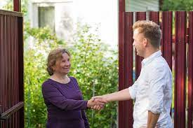
Physical
LT: To describe ways of being safe in communites.

Slide 10

Spirtual
LT: To celebrate ways of meeting God in our communities.

